Slide 1
Unit 4D
Chain Saw Tasks and Techniques:
Felling (Field Proficiency)

Slide 2
Unit 4D Objective
Demonstrate competence in safely felling trees in the least complex situations.

Slide 3
Instructor Responsibilities
Train students and evaluate their skills.
Make honest, constructive assessments of student performance.
Maintaining safety is your number one concern during the field exercise.
Review the JHA/RA during a tailgate safety session.

Slide 4

Student Responsibilities
W I L D L A N D F I R E C H A I N S A W S
S-212
Take responsibility for your safety and for the safety of all other participants.
Demonstrate cutting area control.
Ask for clarification on
task completion.
Review the JHA/RA.
Unit 4D – Chain Saw Tasks and Techniques: Felling (Field Proficiency)
Slide 4D-4

Slide 5
Student Responsibilities
W I L D L A N D F I R E C H A I N S A W S
S-212
Participate in tailgate safety sessions.
Correctly use all required PPE.
Unit 4D – Chain Saw Tasks and Techniques: Felling (Field Proficiency)
Slide 4D-5

Slide 6

Required PPE for each instructor and student
W I L D L A N D F I R E C H A I N S A W S
S-212
Approved hardhat (full brim or cap style).
Wrap-around eye protection (safety glasses or
shield).
Hearing protection (ear plugs or muffs, approved
for 85 decibels and higher).
Gloves (slip- and cut-resistant and appropriate for the weather conditions).
Long-sleeved shirt appropriate for the weather conditions.
Unit 4D – Chain Saw Tasks and Techniques: Felling (Field Proficiency)
Slide 4D-6

Slide 7

Required PPE for each instructor and student
W I L D L A N D F I R E C H A I N S A W S
S-212
    Pants (loose fitting and long enough to cover boot tops). Do not cut (stag) fire pants to shorten them.
    Heavy-duty, 8-inch-high, laced, water-resistant leather boots (cut-resistant, with ankle support and non-slip soles, appropriate for the weather conditions).
    Approved chain saw chaps (chaps should overlap boot tops by at least 2 inches).
    Appropriate first-aid kit. Employees should carry their own surgical gloves.
    Require students to wear standard fireline clothing and PPE.
Unit 4D – Chain Saw Tasks and Techniques: Felling (Field Proficiency)
Slide 4D-7

Slide 8

Required Tools for each group
W I L D L A N D F I R E C H A I N S A W S
S-212
    Single-bit axe with a 3- to 5‑pound head and sheath
    (straight handle is recommended).
    Plastic wedges (appropriate length to match the tree diameters).
    Approved gas and oil containers.
    Approved belt fire extinguisher (if required).
    Whistle or other signaling device.
    Appropriate tool kit with spare parts.
Unit 4D – Chain Saw Tasks and Techniques: Felling (Field Proficiency)
Slide 4D-8

Slide 9
Required Tools for each group
W I L D L A N D F I R E C H A I N S A W S
S-212
    Tool belt.
    Wedge pouch.
    Chain saw in proper working order.
    Appropriate communication device (radio or cell phone).
    Extra saw chain (correctly filed and maintained).
    For the field exercise, students must have a copy
    of the course JHA listing all emergency evacuation
    and communication procedures.
Unit 4D – Chain Saw Tasks and Techniques: Felling (Field Proficiency)
Slide 4D-9

Slide 10

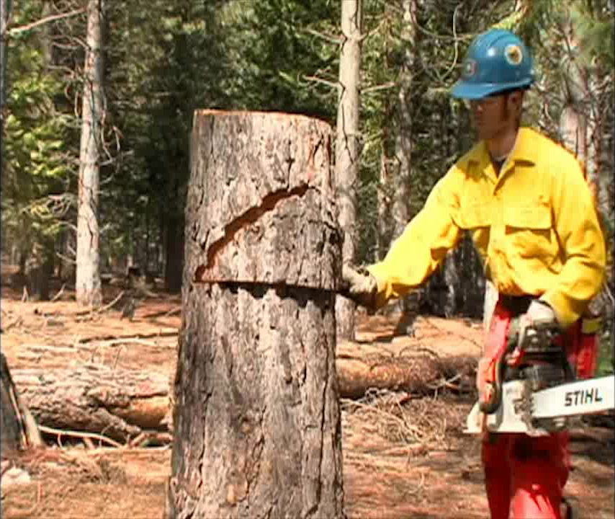
Practice Stumps Video
Click video window to play media.

Slide 11
Skill Demonstrations
The following tasks will be accomplished with a gasoline-powered chain saw equipped with a 16- to 24-inch straight guide bar and all required PPE. Student performance will be documented on the Chain Saw Operator Field Evaluation Form.

Slide 12
Skill Demonstrations:
Felling
Demonstrate the ability to determine and prepare a safe felling area, and maintain cutting area control.
Demonstrate the ability to correctly identify and mitigate overhead and ground hazards associated with tree felling.
Given a sound tree or snag, up to 20 inches dbh, in a closed stand of timber on slopes less than 30%, the student will correctly size up the tree, prepare the intended lay and escape routes, and fell the tree(s) within 15 feet of the center of the intended lay measured at the top of the tree.
Demonstrate the ability to complete a stump analysis of the student’s evaluation tree(s).

Slide 13
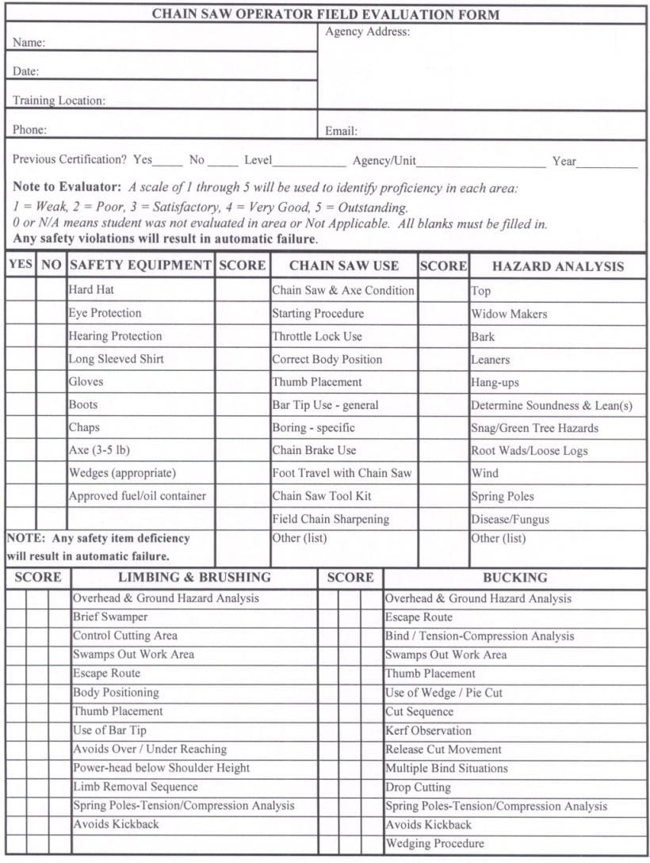
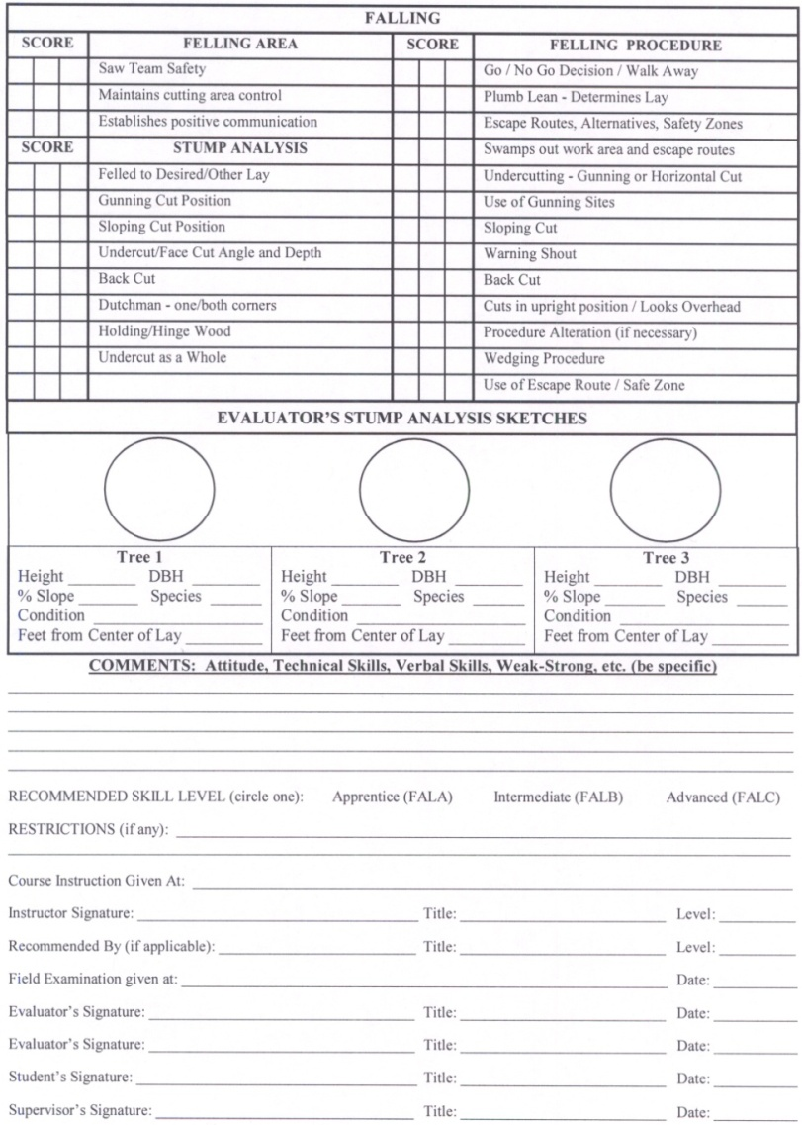
Field Evaluation Form

Slide 14
Review Unit 4D Objective
Demonstrate competence in safely felling trees in least complex situations.

Slide 15
Review Course Objectives
At the completion of the S-212 Wildland Fire Chain Saws course, the student will be able to:
Define and apply chain saw safety standards as required by OSHA and agency handbooks, manuals, directives, and owner’s manuals.
Identify and demonstrate basic chain saw operation, troubleshooting, maintenance, and safety features.

Slide 16
Review Course Objectives (cont.)
Demonstrate the tactical application of chain saws in fireline construction and mop up operations.

