Slide 2
Unit 4B Objectives
Demonstrate competence in safely handling, bucking, limbing, and brushing and slashing in the least complex situations.
Demonstrate safe cutter and swamper interaction.

Slide 3
Instructor Responsibilities
Train and evaluate student skills.
Make honest, constructive assessment of student performance.
Maintain safety as the number one concern during the field practicum.
Review the JHA/RA during a tailgate safety session.

Slide 4

Student Responsibilities
W I L D L A N D F I R E C H A I N S A W S
S-212
Take responsibility for your safety and for the safety of all other participants.
Demonstrate cutting area control.
Ask for clarification on
task completion.
Review the JHA/RA.
Unit 4B – Handling, Bucking, Limbing, and Brushing and Slashing (Field Proficiency)
Slide-4-4

Slide 5
Student Responsibilities
W I L D L A N D F I R E C H A I N S A W S
S-212
Participate in tailgate safety sessions.
Correctly use all required PPE.
Unit 4B – Handling, Bucking, Limbing, and Brushing and Slashing (Field Proficiency)
Slide 4B-5

Slide 6
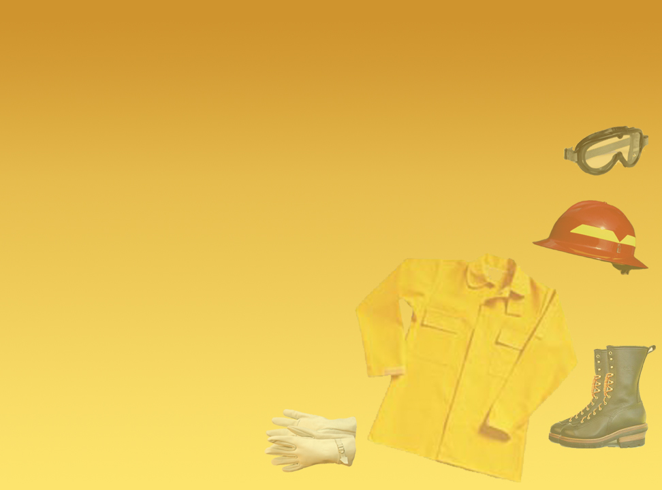
Required PPE for each instructor and student
Approved hardhat (full brim or cap style).
Wrap-around eye protection (safety glasses or shield).
Hearing protection (ear plugs or muffs, approved for 85 decibels and higher).
Gloves (slip- and cut-resistant and appropriate for the weather conditions).
Long-sleeved shirt appropriate for the weather conditions.
Slide 4B-6

Slide 7

Required PPE for each instructor and student
    Pants (loose fitting and long enough to cover boot tops). Do not cut (stag) fire pants to shorten them.
    Heavy-duty, 8-inch-high, laced, water-resistant leather boots (cut-resistant, with ankle support and non-slip soles, appropriate for the weather conditions).
    Approved chain saw chaps (chaps should overlap boot tops by at least 2 inches).
Appropriate first-aid kit. Employees should carry their own surgical gloves.
    Require students to wear standard fireline clothing and PPE.
Slide 4B-7

Slide 8
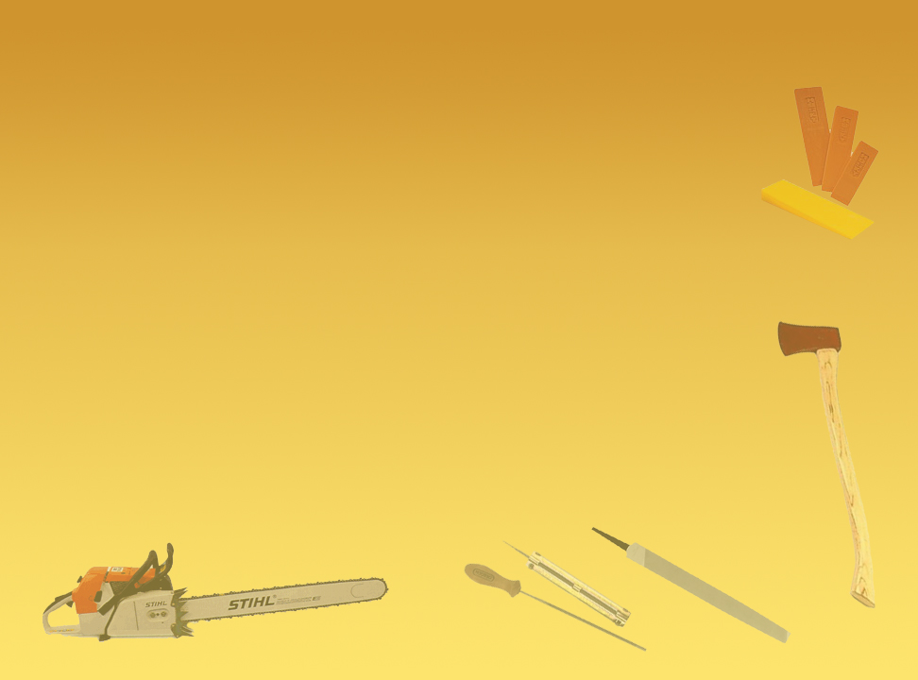
Required Tools for each group
    Single-bit axe with a 3- to 5‑pound head and sheath (straight handle is recommended).
    Plastic wedges (appropriate length to match the tree diameters).
    Approved gas and oil containers.
    Approved belt fire extinguisher (if required).
    Whistle or other signaling device.
    Appropriate tool kit with spare parts.
Slide 4B-8

Slide 9
Required Tools for each group
    Tool belt.
    Wedge pouch.
    Chain saw in proper working order.
    Appropriate communication device (radio or cell phone).
    Extra saw chain (correctly filed and maintained).
    For the field exercise, students must have a copy of the course JHA listing all emergency evacuation and communication procedures.
Slide 4B-9

Slide 10
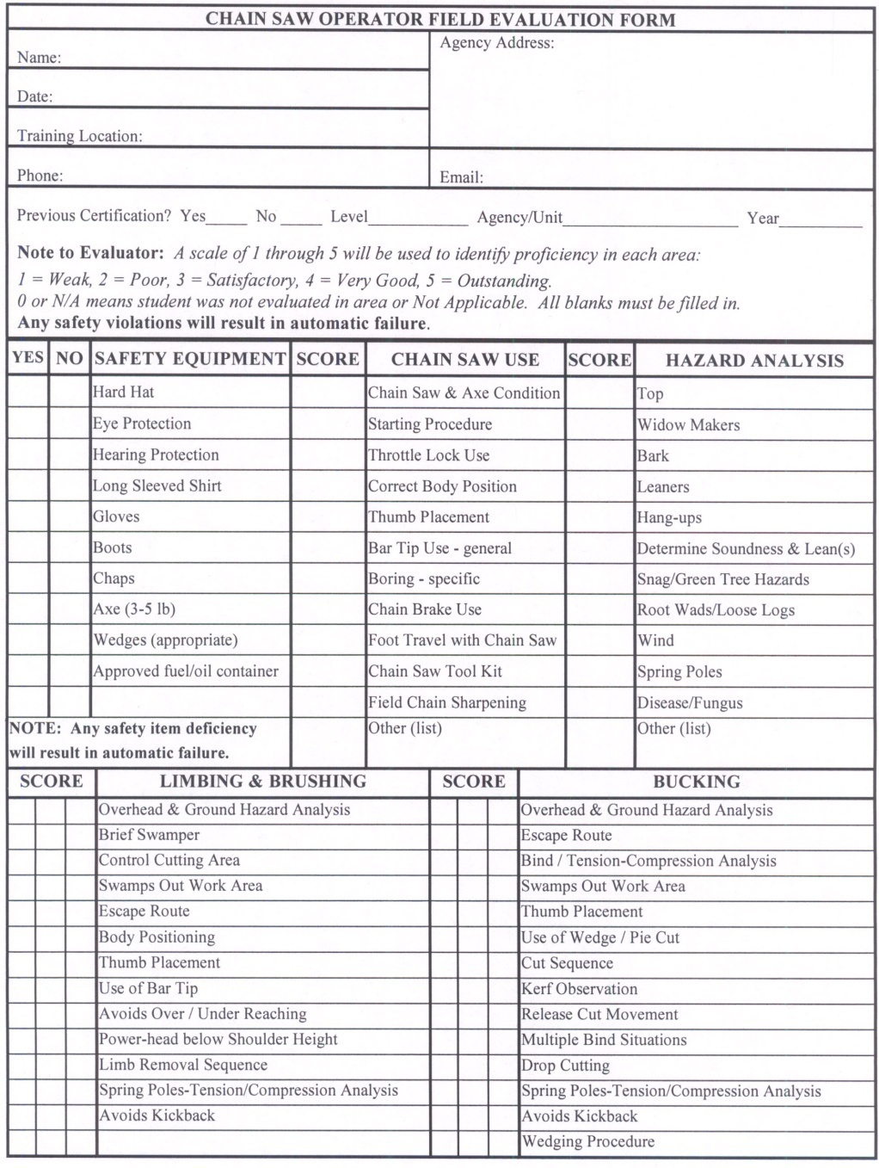
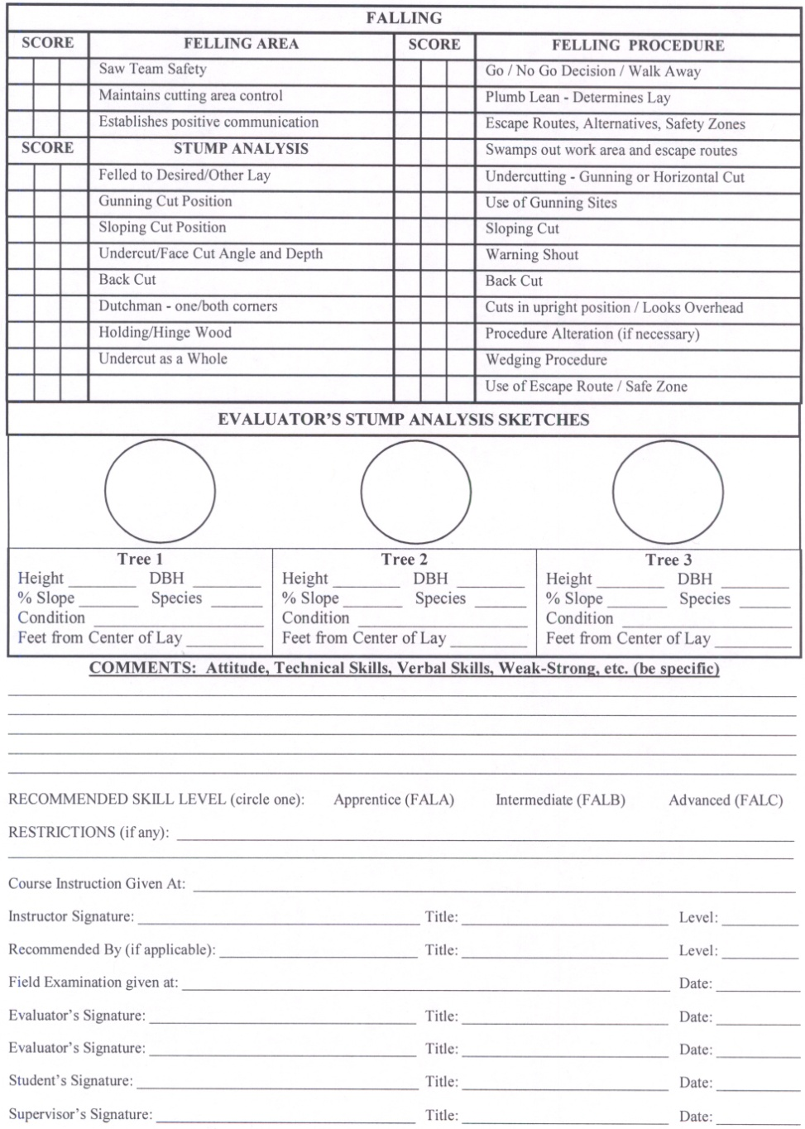
Field Evaluation Form

Slide 11
Skill Demonstrations
Handling, Bucking, Limbing, and
Brushing and Slashing
Demonstrate approved starting methods.
Demonstrate overhead and ground hazard analysis.
Given a standing tree with limbs near the ground in a closed stand of timber, the student will properly size up, clear the work area, and limb the tree to the height of their head.
Given a brush field, the student will properly size up, clear the work area, and cut and remove a strip of brush to near ground level 6 feet wide by 20 feet long.

Slide 12
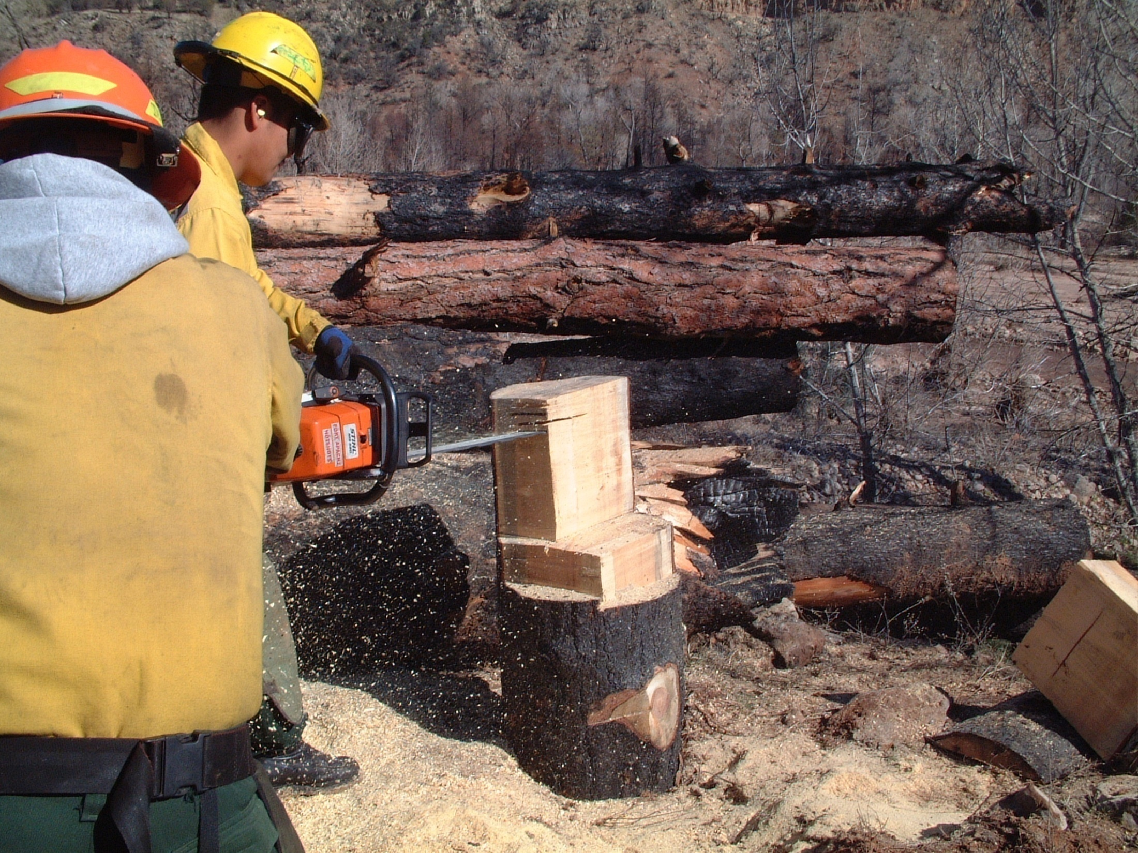
Skill Demonstrations
Handling, Bucking, Limbing, and Brushing and Slashing
W I L D L A N D F I R E C H A I N S A W S
S-212
• Given a prepared sound stump (12 to 18 inches in diameter), the student will execute a horizontal bore cut through the stump that varies no more than
3/8 inch in width from the point of beginning to exit.
• Given a downed tree on a slope up to 30 percent, the student will properly size up, clear the work area, and buck and limb the tree into lengths suitable for hand removal.
Unit 4B – Handling, Bucking, Limbing, and Brushing and Slashing (Field Proficiency)
Slide 4-12

Slide 13
Cutter and Swamper Interaction
Identify one person to be the primary swamper. This is the only person allowed to enter the blood bubble.
Agree on communication, tactics, and responsibilities.

Slide 14
Review Unit 4B Objectives
Demonstrate competence in safely handling, bucking, limbing, and brushing and slashing in the least complex situations.
Demonstrate safe cutter and swamper interaction.

